Slide 1
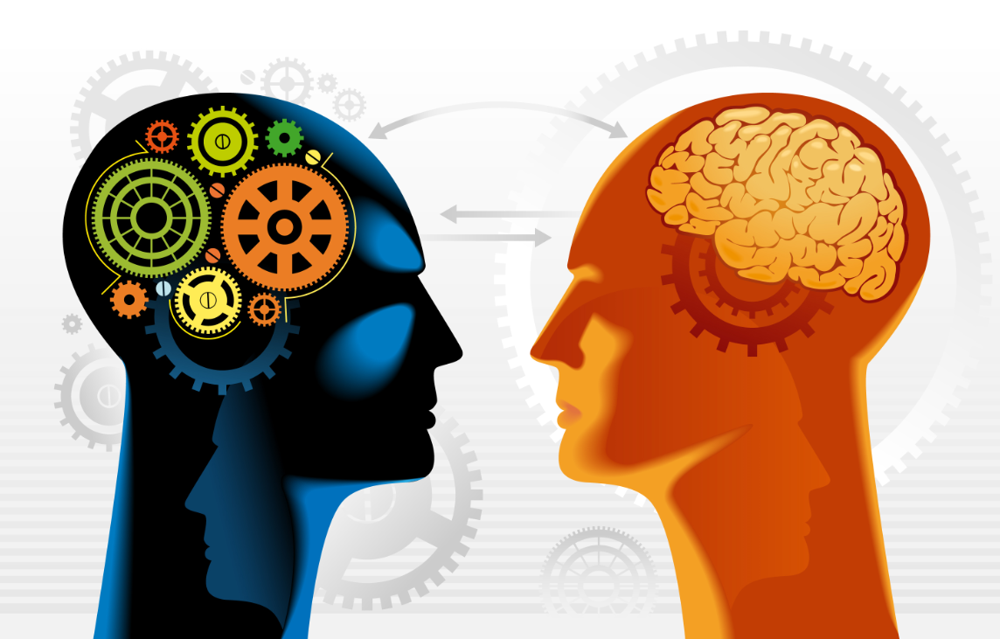
DSCI 6004-01
Natural Language Processing
Vineeth Paradesi
Venkata Geethika Myneni
Himagiri Bhavani Appisetty

Slide 2
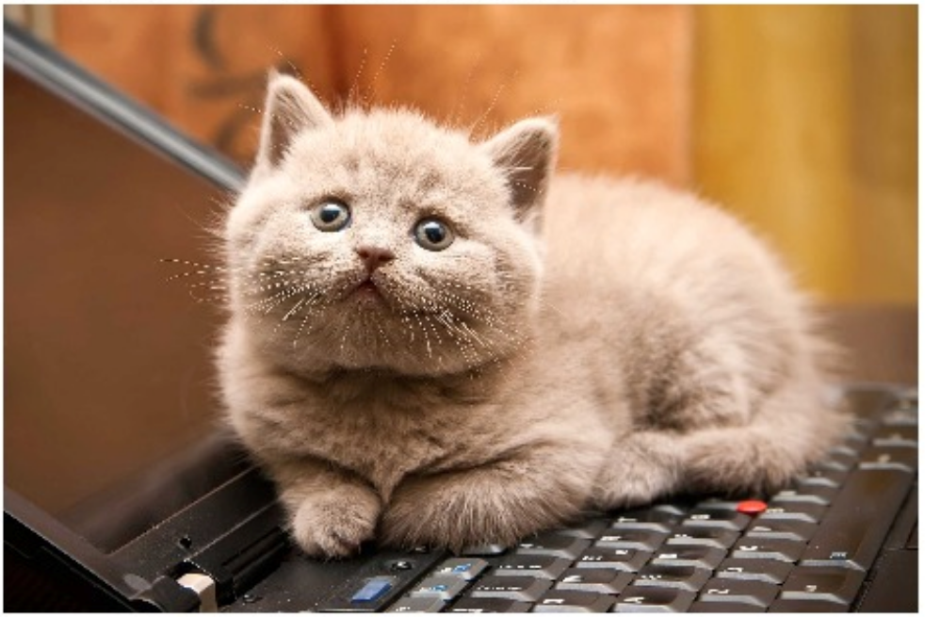
Image Caption Generator
A cat lying on top of a laptop keyboard

Slide 3
Objectives
Develop a deep learning model that can automatically generate captions for images.
Achieve high caption accuracy by effectively capturing the content and context of the image.
Explore and experiment with different deep learning architectures such as VGG16,VGG19 and ResNet50 for image captioning on different datasets .

Slide 4
Why is this project worth doing?
This project has the potential to improve image accessibility for visually impaired individuals.
The generated captions can provide valuable insights for image understanding and retrieval tasks.
It can be used for image search engines, social media platforms, and automated content creation.

Slide 5
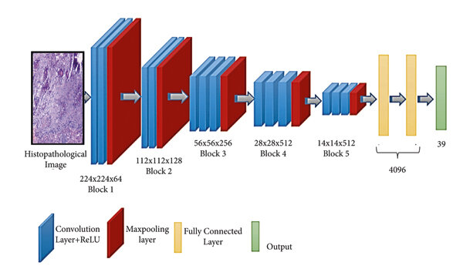
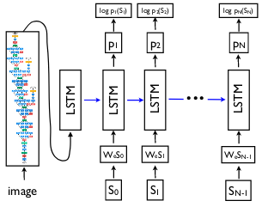
Review of the State-of-the-art

Slide 6
Approach
DATA
Utilize publicly available image captioning datasets like Flickr8k
Model
Implement an encoder decoder architecture with pretrained CNN for feature extraction and LSTM for caption generation.
Training
Train the model on chosen dataset with appropriate hyperparameter tuning for optimal performance
Evaluation
Will evaluate the model using BLEU

Slide 7
Proposed deliverables
Deliverable 1
Trained deep learning model for image caption generation.
Deliverable 2
Code repository containing the implemented model and training scripts.
Deliverable 3
A comprehensive report detailing the project methodology, results, and evaluation.
Deliverable 4
Sample captions generated by the model for a set of test images.

Slide 8
Evaluation Methodology
We will compare the generated captions with human-written references using BLEU score metrics.
Higher scores indicate better caption accuracy and similarity to human-written descriptions.
We will also conduct a qualitative evaluation by visually inspecting the generated captions and assessing their coherence and relevance to the image content.

Slide 9
References
Yin, Xinqiang & Wei, Xiukun & Tang, Qingfeng. (2024). Automatic Generation of Pantograph Image Caption Based on Deep Learning. 163-172. 10.1007/978-981-99-9315-4_18.
Ansari, Khustar & Srivastava, Priyanka. (2024). An efficient automated image caption generation by the encoder decoder model. Multimedia Tools and Applications. 1-26. 10.1007/s11042-024-18150-x.

